Slide 1
FLOCK Fast, Lightweight, and Scalable Allocation for Decentralized Services on Blockchain
Navin V. Keizer, Onur Ascigil, Ioannis Psaras, George Pavlou
May 2021
IEEE International Conference on Blockchain and Cryptocurrency

Slide 2


Towards a Decentralized Future
Building blocks of a decentralized Web
Blockchains and DLTs
Decentralized Storage Networks
Network Resource Sharing Services

Slide 3





Network Resource Sharing Services
Sell spare network resources off-chain, in return for cryptocurrency rewards
B
A
Storage sharing example

Slide 4





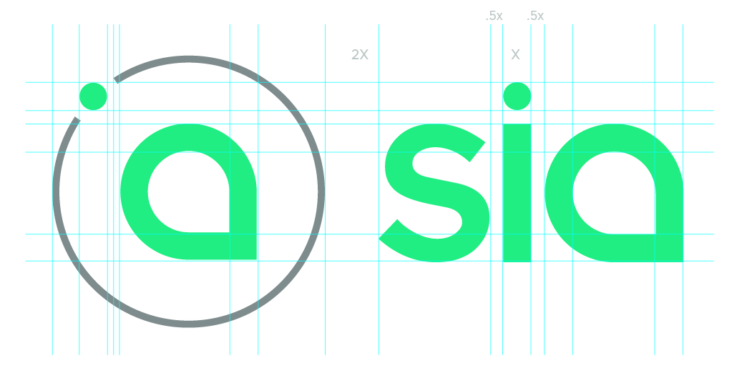


Decentralized Service Examples
Storage
Computation
Bandwidth

Slide 5
Decentralized Service Examples
Leverage Blockchain to provide incentive
Storage
Computation
Bandwidth

Slide 6
How will a node find and be allocated to a service node?

Slide 7
Desirable Allocation Properties
Decentralized
Fast (similar to centralized counterparts)
Lightweight
Scalable
Allow for user preferences of nodes
Derive prices for services

Slide 8
Allocation Triangle
Scalability
Preference
based
Price
Derivation

Slide 9
Option 1: Orderbook on Blockchain
Buyers post a price they are willing to pay on-chain
Sellers post a price they are willing to accept for payment on-chain
They are then matched to each other based on prices

Slide 10
Option 1: Orderbook on Blockchain
Scalability
Orderbook
Preference
based
Price
Derivation

Slide 11
Option 2: Blockchain Auctions
Decentralized auctions are possible using smart contracts
Single-item auctions (e.g. Vickrey)
Multi-item auctions (e.g. VCG)
Sellers set a hidden minimum price for a service on-chain
Buyers submit (sealed) bids for an item to the blockchain
After a collection time, the contract decides the who the auction is

Slide 12
Option 2: Blockchain Auctions
However, auctions are inherently inefficient and slow
Preparation phase delays
Limited amount of allocated nodes in every round
Computation of multi-item auctions can be heavyweight
Might be suitable for small subset of the network

Slide 13
Option 2: Blockchain Auctions
Scalability
Preference
based
Price
Derivation
Auctions

Slide 14


Overview of FLOCK
Decoupled price derivation from allocation computation
Billboard and Oracle
Smart Contracts
Stable Matching
Algorithms
Trusted Execution
Environment

Slide 15
Decentralized Service Types
Matching for a service as single entity
Service is binary: either it is provided or not
Example: Filecoin retrieval market (content is retrieved and delivered)
Matching for a service within a budget
The seller has a budget of the good to be sold, and that it wants to sell as much of it, possibly in smaller chunks
Example: Filecoin storage market (storage budget), DVPN (bandwidth budget)

Slide 16
Stable Matching Algorithms
Stable marriage problem
match 2 sets of nodes with preference lists
Preference lists can be incomplete (SMI)
Used for service type 1
Hospital / residence (HR) problem
match students to placements at hospitals who have a budget
Used for service type 2

Slide 17
Billboard Contract
Orchestrates the beginning phases of allocation
Acts as a billboard for service discovery and participation
Sets parameters for allocation round
Aggregates client / seller registrations
Picks and outsources calculation to TEE

Slide 18
TEE Integration
Trusted Execution Environment is used as a secure computation platform instead of on the smart contract
TEE owners are rewarded using off-chain payments
TEE is picked by smart contract, starts receiving preference lists from registered nodes
TEE loads the allocation algorithm, which nodes can attest, and performs the secure computation
TEE sends the solutions to nodes in return for micropayments

Slide 19
Oracle Contract
The oracle contract dictates a global price for a service
This is done by taking inputs into a smart contracts (s.a. real world data) and performing a price calculation function
E.g. we can use the price of Ethereum as an input to achieve a constant price in fiat terms
Any node can trigger this contract to update a price based on the latest parameters

Slide 20



Smart Contract
Execution Node
Choose TEE
Send Registration List
Update State
Send Registration Nonce
TEE
Send Locked Payment
Calculate Allocation
Unlock Payment
Register
Register
Send Preference List
Start Allocation
Return Solution
Clients
Sellers

Slide 21
Evaluation of FLOCK
Smart contract performance
Cost and scalability of smart contract approach
Comparison against auction based allocation solutions
Matching algorithm performance
Comparison of our matching algorithms against auction algorithms in terms of run time, scalability, throughput

Slide 22
Smart Contracts Cost Comparison
 | FLOCK | PASTRAMI | Trustee
Client | 143827 | 391046 | 1847178
Seller | 92673 | 95934 | 143720
Execution Node | * | 7108 | *
Gas costs compared to auctions
Function | Gas Cost
Deploy Contract | 213008
Setup Oracle | 71360
Update Oracle | 56931
Gas costs per function

Slide 23
Allocation Run Time Comparison
Single-item allocation
Multi-item allocation

Slide 24
Allocation Throughput Comparison
Throughput (max capacity = 3)
Throughput (max capacity = 10)

Slide 25
Final Thoughts
Could use a combination of auctions and matching allocations
Auctions for popular or spare items
Matchings for the bulk of allocation
Off-chain storage needed for intermediate states
Smart contract should outsource storage of registration data
Extension possible for real-time allocation
Can perform allocation predictively before query comes in

Slide 26
Thank You!
FLOCK: Fast, Lightweight, and Scalable Allocation for Decentralized Services on Blockchain
Navin.Keizer.15@ucl.ac.uk
May 2021
IEEE International Conference on Blockchain and Cryptocurrency

